Slide 1
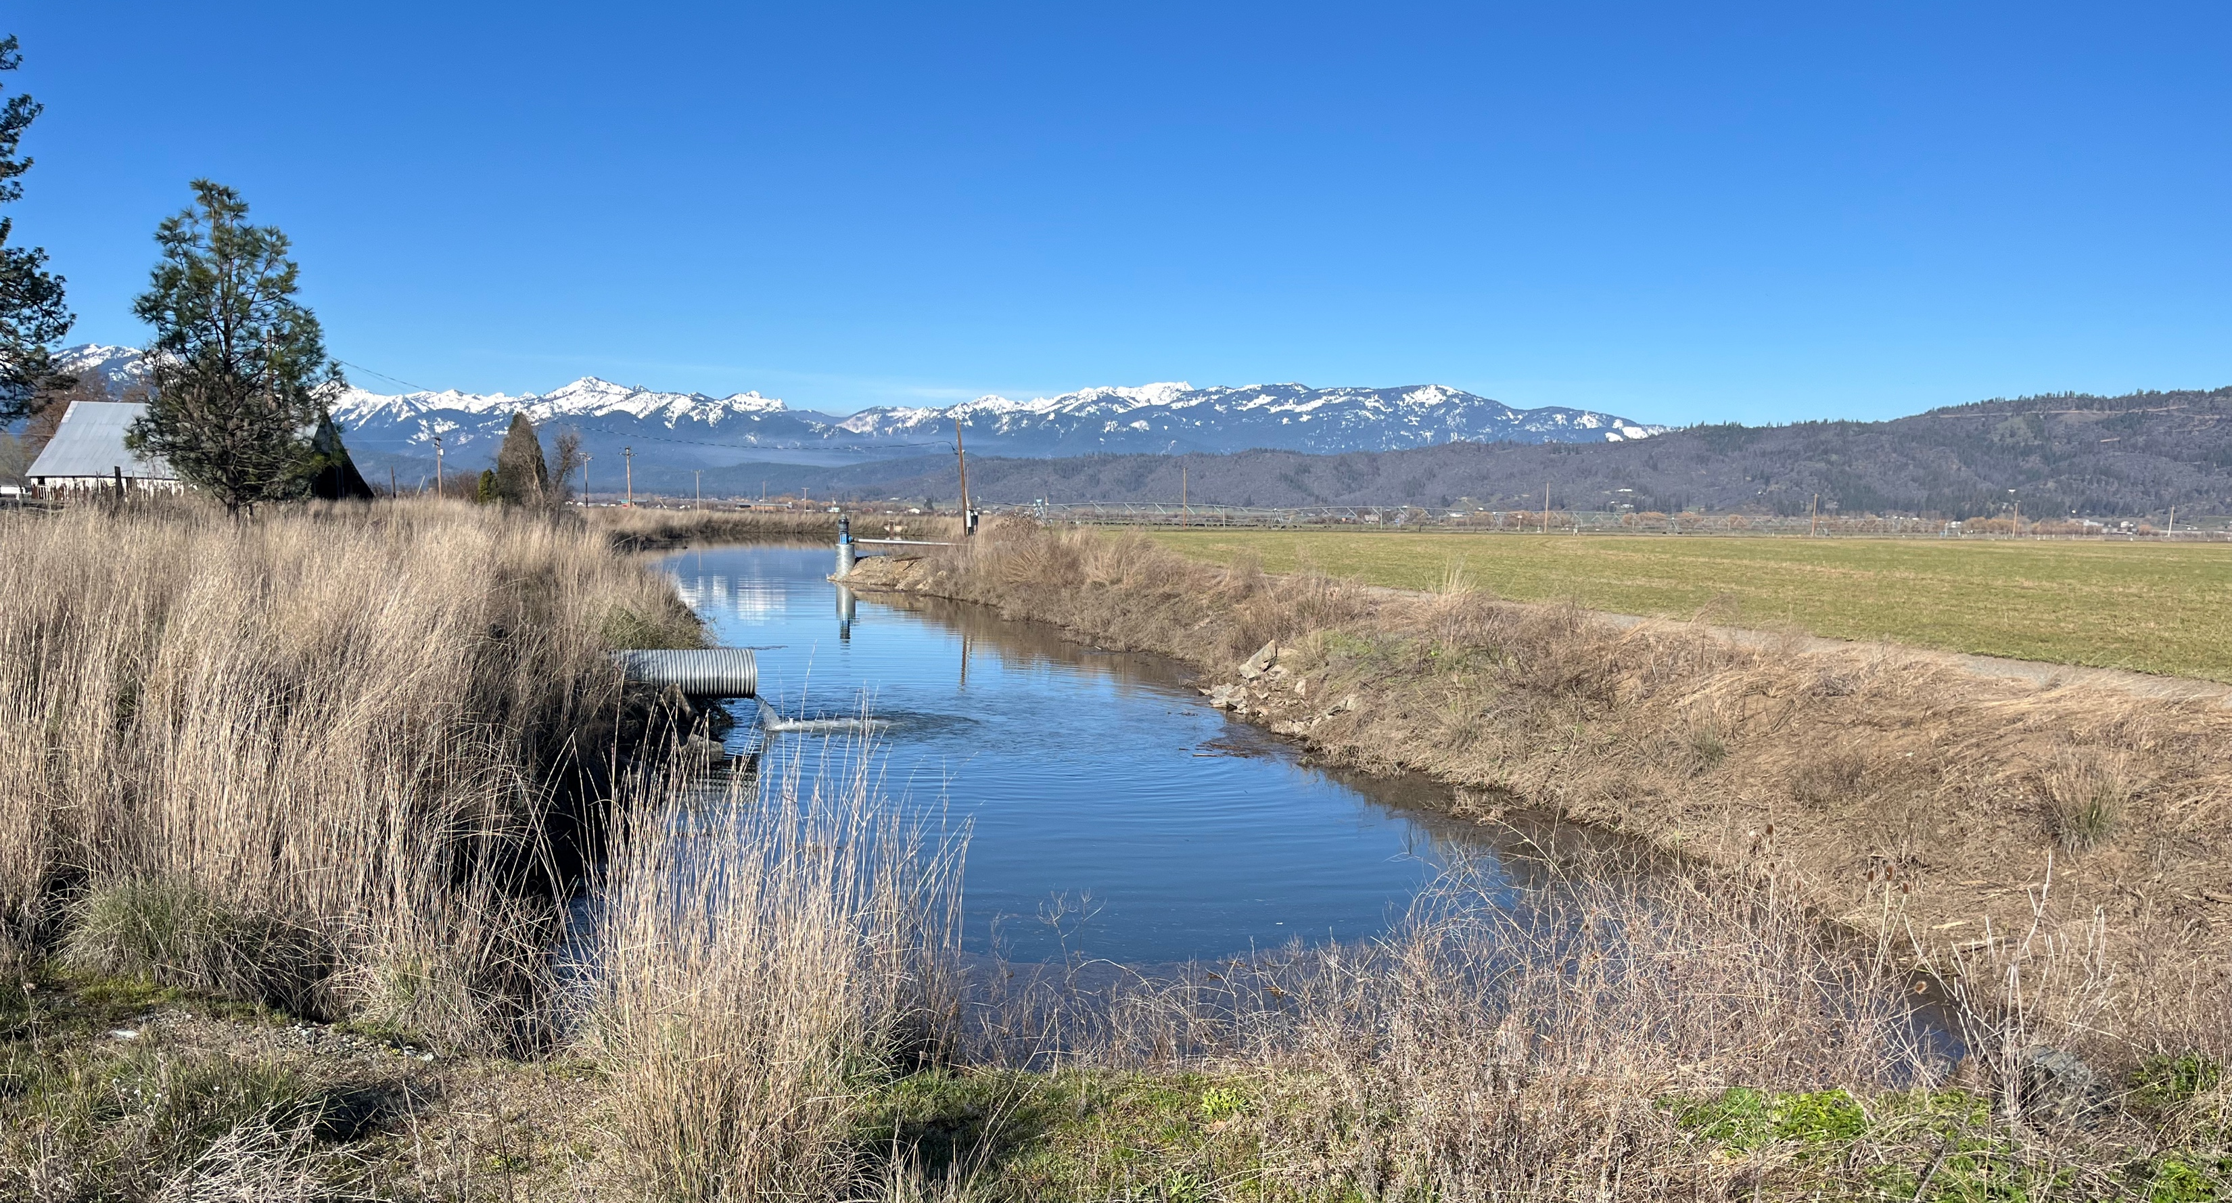
Well Permit Testing Update - May 2024

Slide 2
Approach to comply with Executive Order
Use Butte Valley as example
Evaluate depth and capacity of wells and run model scenarios looking at hypothetical new wells with a combination of depth and capacity
Evaluate drawdown at the well and radius of influence
Next steps:
Develop a well inventory to include consideration of possible impact to nearby wells
For each zone withing the Butte valley basin, develop tables with criteria to provide preliminary guidelines
Same approach can be then implemented in Scott and Shasta

Slide 3
DWR Well Completion Report dataset
Not all wells provide reports
Not all drillers pump test data
Pumping rates may be wrong
The best available data for an initial study
Only considering non-exempt wells under the Executive Order
Only considering wells since 1989 to gain an understanding of recent conditions

Slide 4
Total Depth of non-exempt wells in Butte
Total Completed Depth dataset is complete. All wells provide depth data
The average depth is 448 feet
The median depth is 400 feet (half are deeper and half are shallower)

Slide 5
Well Yield of non-exempt wells in Butte
37 out of 43 non-exempt wells provided pump test data from 1989-2024
The average yield is 1355 gpm
The median yield is 1387 gpm (half are less and half are more)

Slide 6
138 hypothetical wells
PUMPING SCENARIOS:
A variety of pumping scenarios considered (depth, rate):
Depth: 200, 400, 600, 800, 1200 ft
Capacity: 600, 800, 1200, 1600, 2000, 2500, and 3000 gpm
Predictions were made by placing a hypothetical well within the Butte Valley Basin
Observing drawdown as predicted by the model
23 combinations of well construction
6 preliminary locations in and around Butte Valley

Slide 7
Approximate Well Locations
Approximate locations of non-domestic well in the Butte Valley area.
Circled area are where hypothetical pump tests are being calculated
The Executive Order allows setting limits on wells both inside and outside the SGMA basin

Slide 8
Limitations
The model has generally good correlation between observed and predicted groundwater levels
Does not bias significantly to over or under prediction
Not over or under estimating
Still needs further calibration

Slide 9
ZONE 1: North Well
Pumping starts in April
Results are presented for August

Slide 10
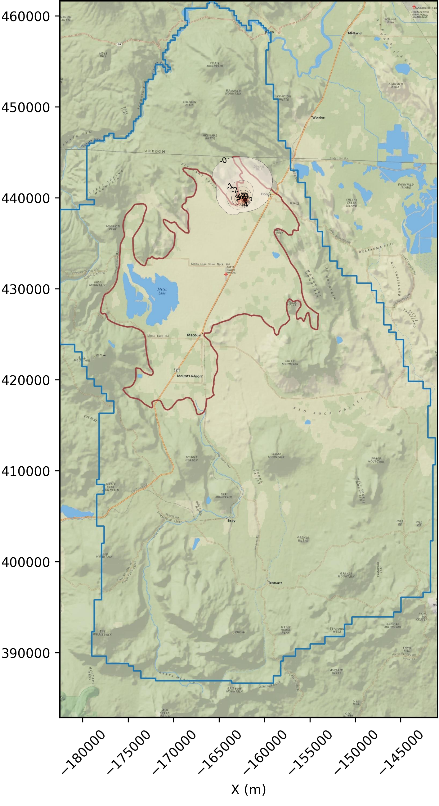
August 2023
August 2023
August 2023
Drawdown at Well Cell: 22.2 ft., rapidly declining to 2 ft within approximately 1 mile
Drawdown at Well Cell: 54.3 ft, takes longer to decline
Drawdown at Well Cell: 123.8 ft, larger impact
Well Depth: 600 ft Pumping rate: 600 gpm
Well Depth: 1200 ft Pumping rate: 1200 gpm
Well Depth: 800 ft Pumping rate: 3000 gpm

Slide 11
ZONE 2: Central Well
Pumping starts in April
Results are presented for August

Slide 12
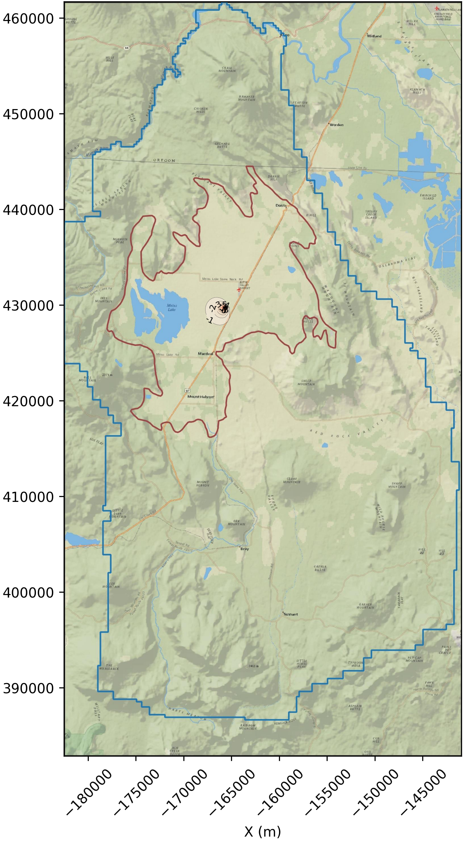
August 2023
August 2023
August 2023
Drawdown at Well Cell: 24 ft.
Drawdown at Well Cell: 54.5 ft.
Drawdown at Well Cell: 130 ft.
Well Depth: 600 ft Pumping rate: 600 gpm
Well Depth: 1200 Pumping rate: 1200 gpm
Well Depth: 800 ft Pumping rate: 3000 gpm

Slide 13
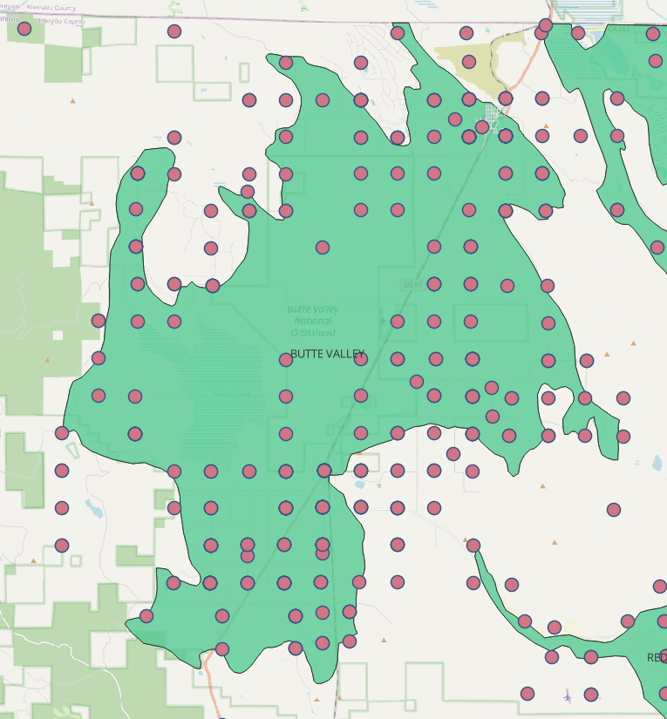
Summary and next steps
Once all the scenarios are finalized: what is the accepted drawdown? Are there other wells nearby?
For each zone, develop summary table:
ZONE | Depth (ft) | Capacity (gpm) | Expected drawdown (ft) | Expected radius of influence (ft) | Are there other wells nearby? | Can it be permitted or needs more analysis?
1 | 800 | 3000 | 10 | 1000 | Yes | Needs more analysis

Slide 14
Thank You

